Slide 1
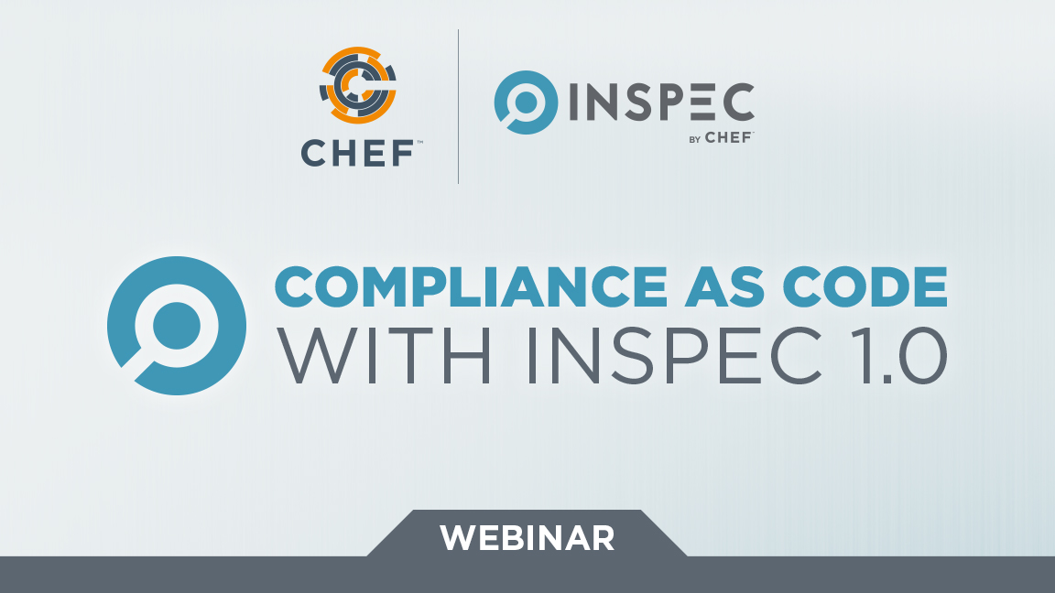

Slide 2


Christian Johannsen
Introductions
Solutions Architect EMEA
@cjohannsen81

Slide 3
The tradeoff myth
QUALITY
Quality/
Security/
Compliance
Innovation
VELOCITY

Slide 4
The changing role of the compliance officer

Slide 5

InSpec turns infrastructure testing, compliance and security requirements into code
Stats: 86 Releases, 59 Contributors, 2.900 Commits

Slide 6
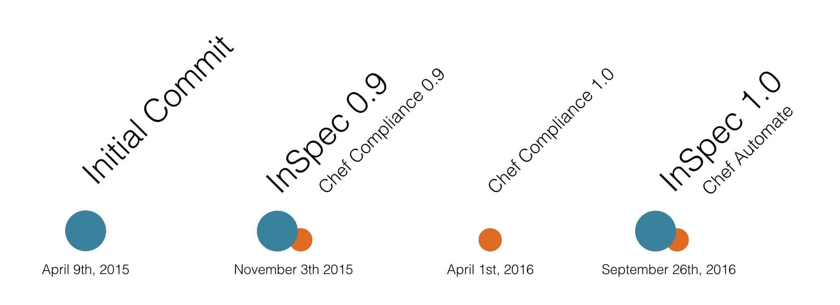
InSpec History

Slide 7


InSpec Contributors

Slide 8



InSpec 1.0 – What’s New?
Mechanisms for Policy Definitions
Profile Inheritance
Attributes
Custom Resources
Improved Windows Support
Windows 2016 / Nano Support
Windows-specific Resources
PowerShell remoting protocol with NTLM support
Native Packages
Windows
macOS
Redhat & Ubuntu
Remote and agent-based execution
Custom sudo commands
more ssh options
Patch Management
windows-patch-benchmark (dev-sec.io)
linux-patch-benchmark (dev-sec.io)
Chef Ecosystem
Included in ChefDK package
Kitchen support
audit cookbook

Slide 9
Standalone Usage
describe sshd_config do
its('Protocol') { should cmp 2 }
end
$ inspec exec test.rb
$ inspec exec test.rb -i vagrant.key -t ssh://root@172.17.0.1:11022
$ inspec exec test.rb -t winrm://Admin@192.168.1.2 --password super
$ inspec exec test.rb -t docker://3cc8837bb6a8

Slide 10
Test remote via SSH
inspec exec test.rb -i vagrant.key -t ssh://root@172.17.0.1:11022
no Ruby / agent on the node

Slide 11
Test remote via WinRM
inspec exec test.rb -t winrm://Admin@192.168.1.2 --password super
no Ruby / agent on the node

Slide 12
Test docker container
inspec exec test.rb -t docker://3cc8837bb6a8
no SSH / agent on the container

Slide 13
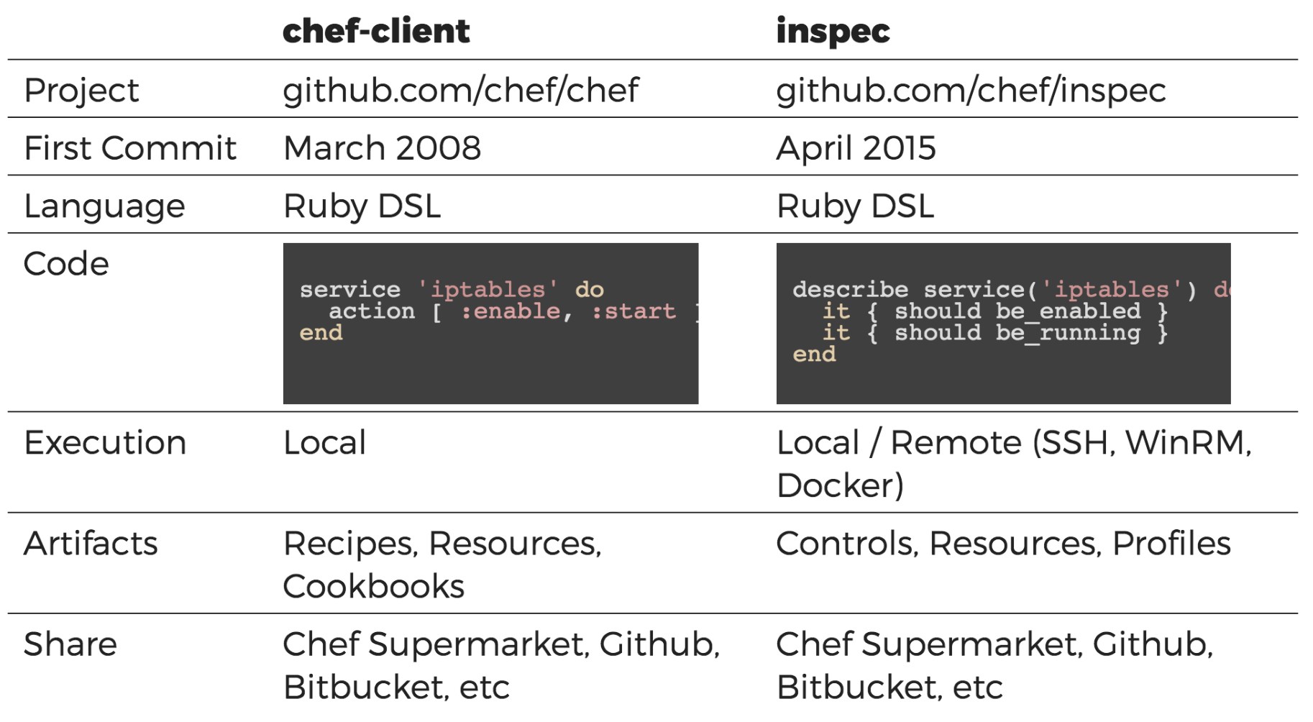
Chef vs InSpec

Slide 14
Compliance language
control 'ssh-1234' do
impact 1.0
title 'Server: Set protocol version to SSHv2'
desc "
Set the SSH protocol version to 2. Don't use legacy
insecure SSHv1 connections anymore...
"
describe sshd_config do
its('Protocol') { should cmp 2 }
end
end

Slide 15
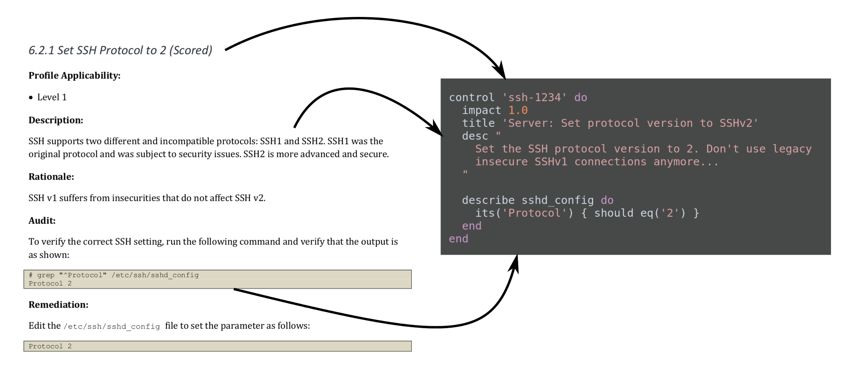
Mapping of Compliance Document to InSpec

Slide 16
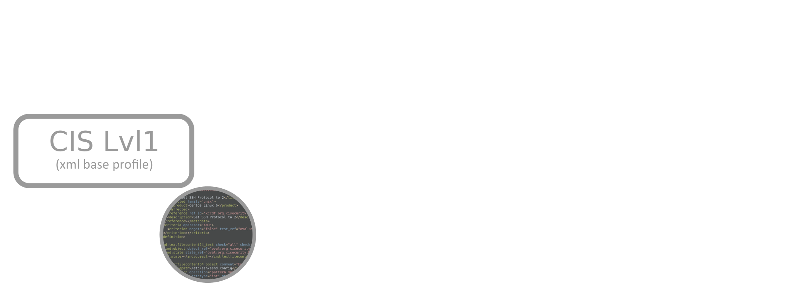
Compliance Profile foundation

Slide 17
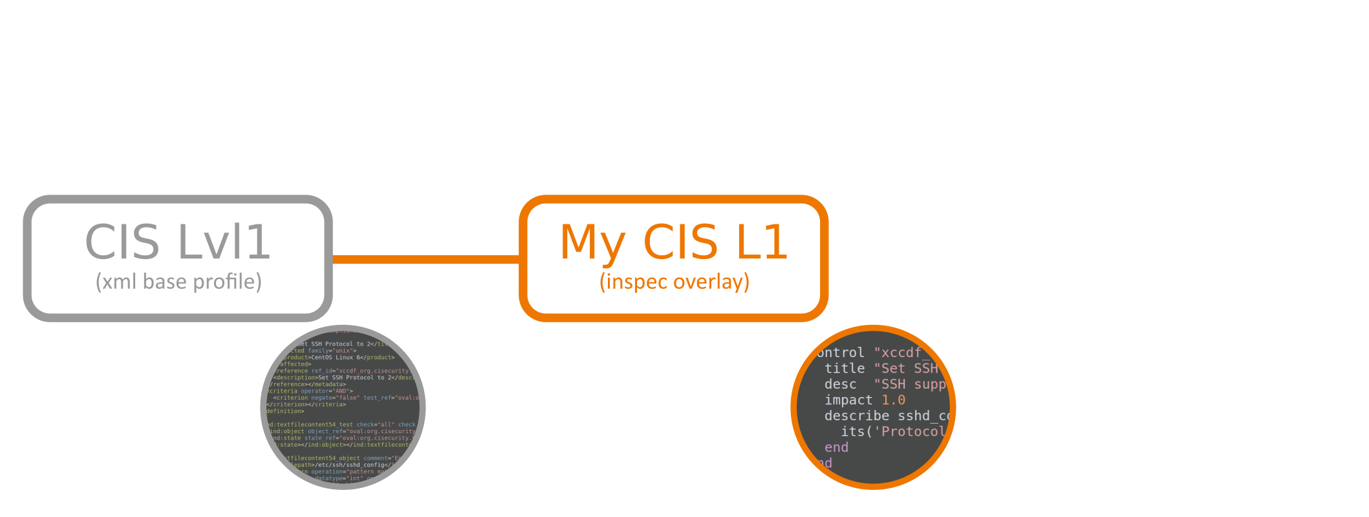
Compliance Profile adjustments

Slide 18
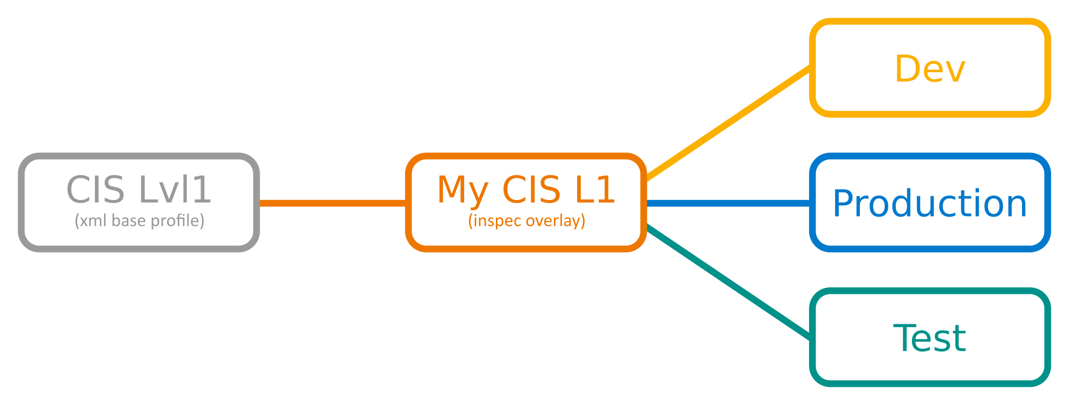
Compliance Profile adjustments

Slide 19

Works with all DevOps tools e.g.

Slide 20
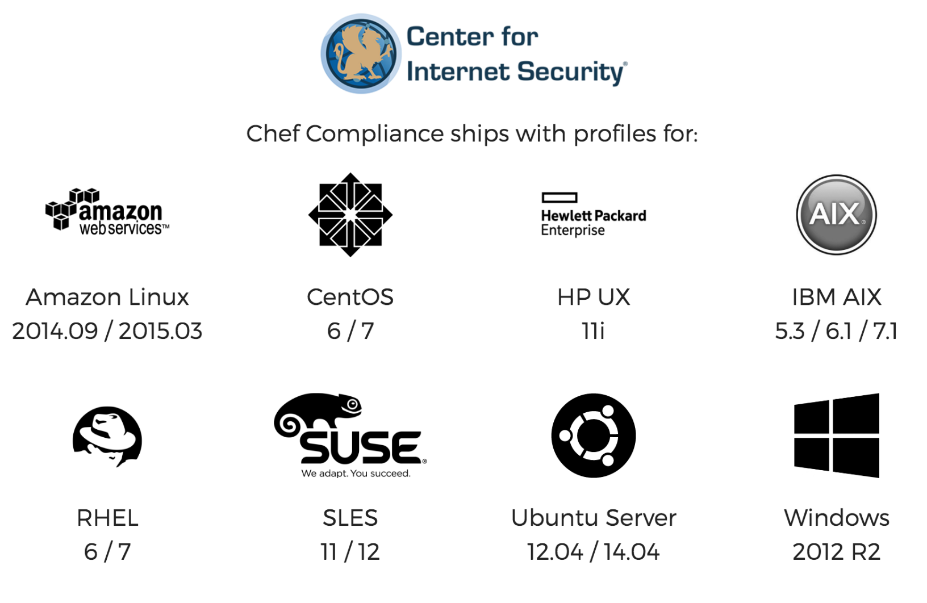
Chef Automate
7/8/

Slide 21
Custom resources
control 'tls1.2' do
title 'Run TLS 1.2 whenever SSL is active on a port'
impact 0.5
port.protocols(/tcp/).entries.each do |socket|
describe ssl(port: socket.port).protocols('tls1.2') do
it { should be_enabled }
end
end
end
control 'ssl2' do
title 'Disable SSL2 from all exposed SSL ports.'
impact 1.0
port.protocols(/tcp/).entries.each do |socket|
describe ssl(port: socket).protocols('ssl2') do
it { should_not be_enabled }
end
end
end

Slide 22
Custom resources
class SSL < Inspec.resource(1)
name 'ssl'
desc "
SSL test resource
"
def initialize(opts = {})
@host = opts[:host]
@port = opts[:port]
...
end
def enabled?
res = SSLShake.hello(@host, protocol: 'tcp', port: @port)
res['success']
end
end

Slide 23

Compliance as code

Slide 24
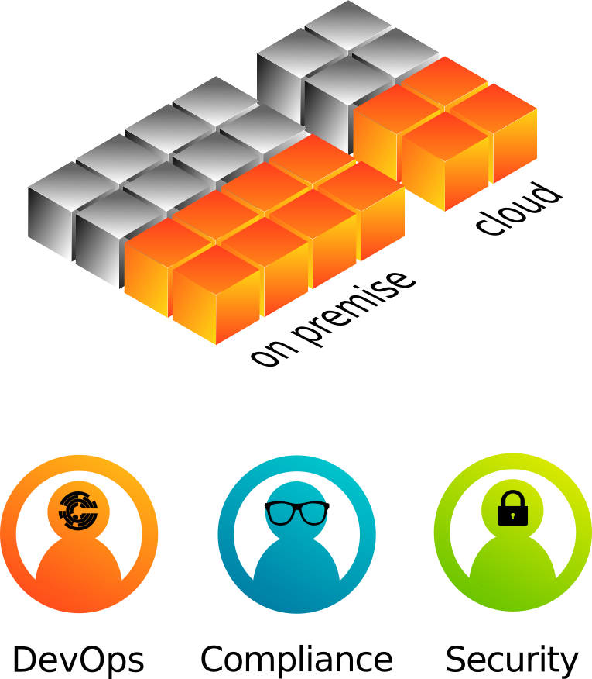
Compliance as code – as a team

Slide 25

Compliance as code – every stage
Development | Staging | Production
Chef | Chef | Chef
Test Kitchen | Workflow CI/CD | Chef Server
ServerSpec | ChefSpec Rubocop | Security Tool

Slide 26
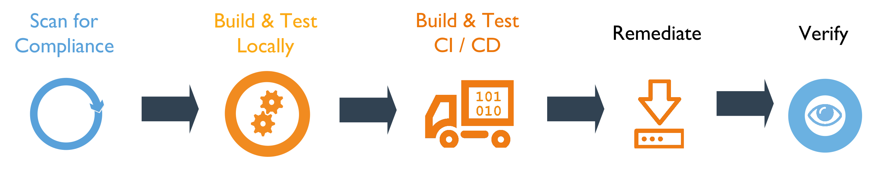
Compliance as code – continuous

Slide 27
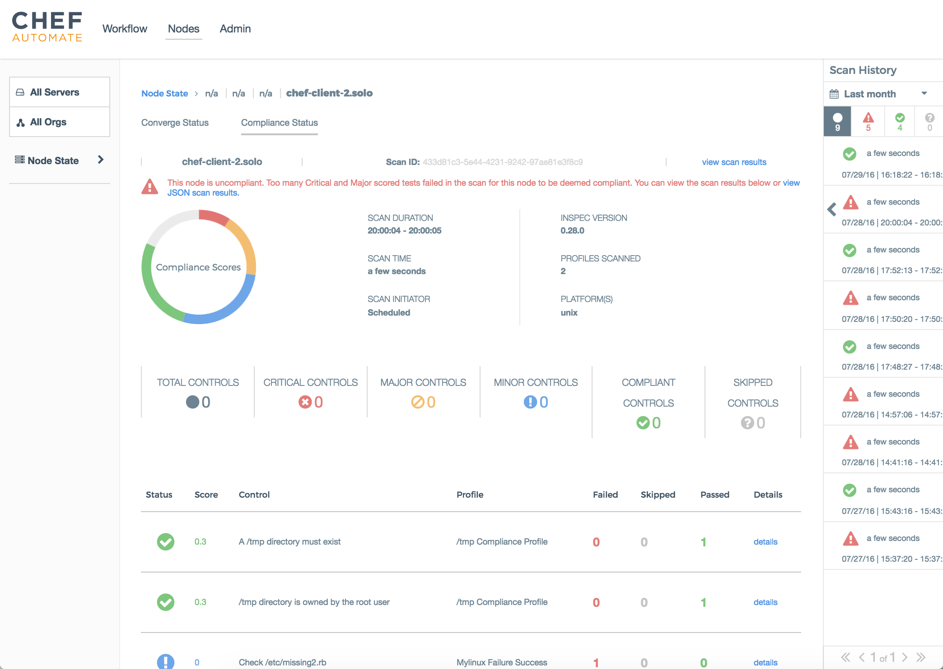
Compliance as code – visible

Slide 28

Demo Time!

Slide 29
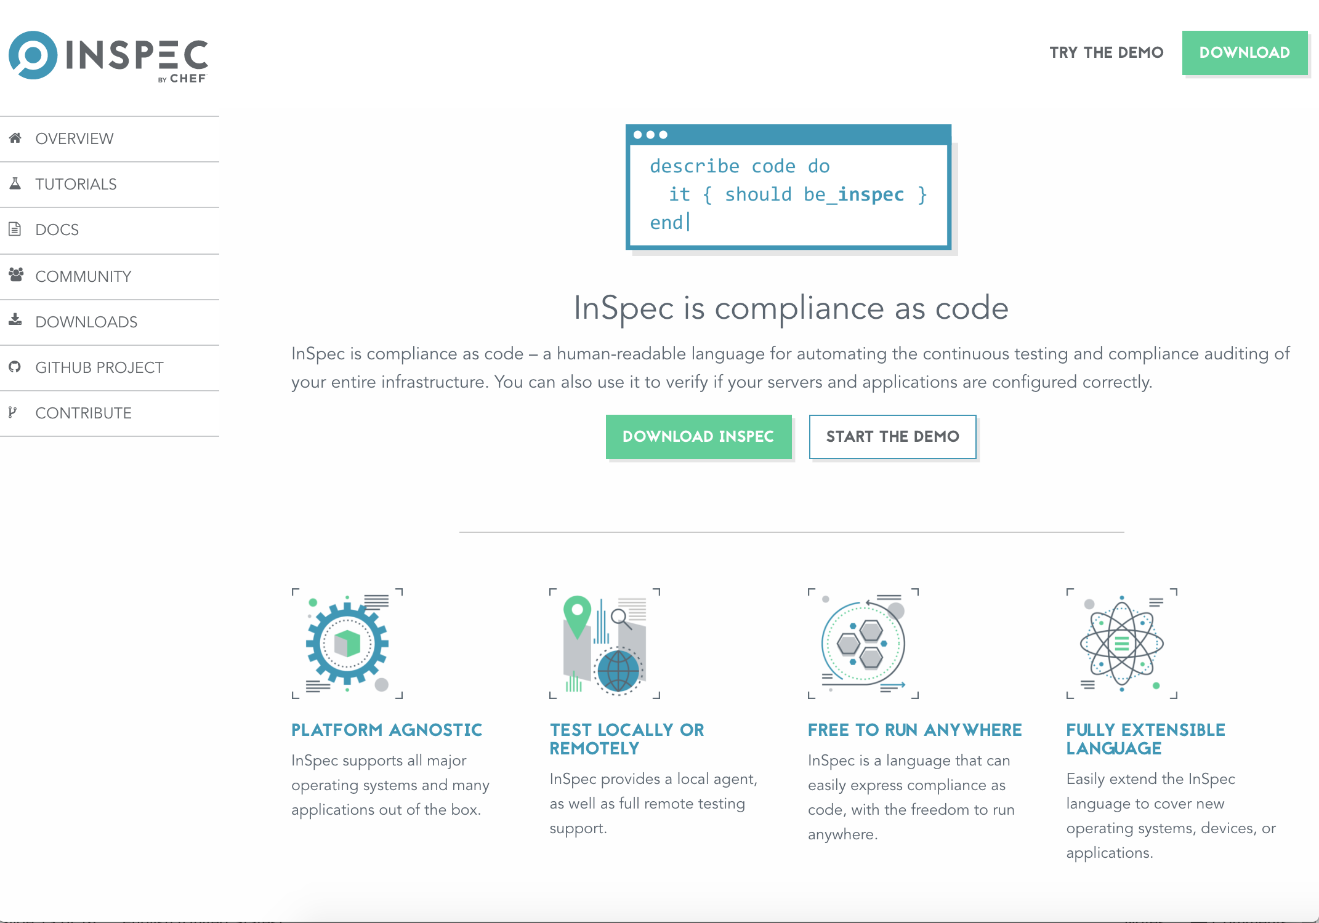
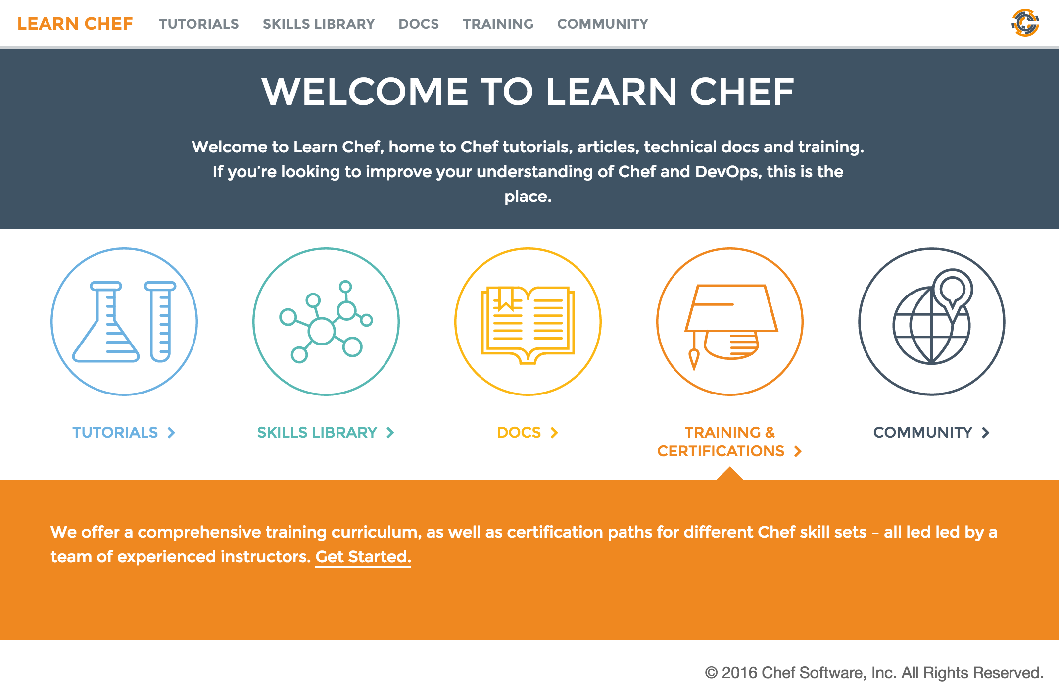
Further Resources
inspec.io
Hands on tutorials
Extensive documentation
Code examples
learn.chef.io
More tutorials about Compliance and Inspec

Slide 30

Further Resources
Save Your Crash Dummies! A Test-driven Infrastructure Solution
http://bit.ly/crash_dummies

Slide 31
Q&A
http://inspec.io
http://learn.chef.io
$ inspec exec <url>
https://github.com/dev-sec/tests-ssh-hardening
https://github.com/dev-sec/windows-patch-benchmark
https://github.com/dev-sec/linux-patch-benchmark

